Slide 1

Chapter 5
Industry and Competitor Analysis
Bruce R. Barringer
R. Duane Ireland
Copyright ©2016 Pearson Education, Inc.
5-‹#›

Slide 2
Chapter Objectives
Explain the purpose of an industry analysis.
Identify and discuss the five competitive forces that determine industry profitability.
Explain the value that entrepreneurial firms create by successfully using the five forces model.
Identify the five primary industry types and the opportunities they offer.
Explain the purpose of a competitor analysis and a competitive analysis grid.
Copyright ©2016 Pearson Education, Inc.
5-‹#›

Slide 3
What is Industry Analysis?
Industry
An industry is a group of firms producing a similar product or service, such as music, Pilates and yoga studios, and solar panel manufacturing.
Industry Analysis
Is business research that focuses on the potential of an industry.
Copyright ©2016 Pearson Education, Inc.
5-‹#›

Slide 4
Why is Industry Analysis Important?
Importance
Once it is determined that a new
venture is feasible in regard to the
industry and market in which it
will compete, a more in-depth
analysis is needed to learn the ins
and outs of the industry.
The analysis helps a firm determine
if the target market it identified
during feasibility analysis is
favorable for a new firm.
Industry Analysis
Copyright ©2016 Pearson Education, Inc.
5-‹#›

Slide 5
Three Key Questions
When studying an industry, an entrepreneur must answer three questions before pursuing the idea of starting a firm.
Is the industry
accessible—in other
words, is it a realistic
place for a new
venture to enter?
Question 1
Does the industry
contain markets that
are ripe for innovation
or are underserved?
Question 2
Are there positions in
the industry that avoid
some of the negative
attributes of the
industry as a whole?
Question 3
Copyright ©2016 Pearson Education, Inc.
5-‹#›

Slide 6
How Industry and Firm-Level Factors Affect Performance
Firm-Level Factors
Include a firm’s assets, products, culture, teamwork among its employees, reputation, and other resources.
Industry-Level Factors
Include threat of new entrants, rivalry among existing firms, bargaining power of buyers, and related factors.
Conclusion
In various studies, researchers have found that from 8% to 30% of the variation in firm profitability is directly attributable to the industry in which a firm competes.
Therefore, the overall attractiveness of an industry should be part of the equation when an entrepreneur decides whether to pursue a particular opportunity.
Copyright ©2016 Pearson Education, Inc.
5-‹#›

Slide 7
Techniques Available to Assess Industry Attractiveness
Assessing Industry Attractiveness
Study Environmental
and Business Trends
The Five Competitive
Forces Model
Copyright ©2016 Pearson Education, Inc.
5-‹#›

Slide 8
Studying Industry Trends
Environmental Trends
Include economic trends, social trends, technological advances, and political and regulatory changes.
For example, industries that sell products to seniors are benefiting by the aging of the population.
Business Trends
Other trends that impact an industry.
For example, are profit margins in the industry increasing or falling? Is innovation accelerating or waning? Are input costs going up or down?
Copyright ©2016 Pearson Education, Inc.
5-‹#›

Slide 9
The Five Competitive Forces Model 1 of 3
Explanation of the Five Forces Model
The five competitive forces model is a framework for understanding the structure of an industry.
The model is composed of the forces that determine industry profitability.
They help determine the average rate of return for the firms in an industry.
Copyright ©2016 Pearson Education, Inc.
5-‹#›

Slide 10
The Five Competitive Forces Model 2 of 3
Explanation of the Five Forces Model (continued)
Each of the five forces impacts the average rate of return for the firms in an industry by applying pressure on industry profitability.
Well managed firms try to position their firms in a way that avoids or diminishes these forces—in an attempt to beat the average rate of return of the industry.
Copyright ©2016 Pearson Education, Inc.
5-‹#›

Slide 11
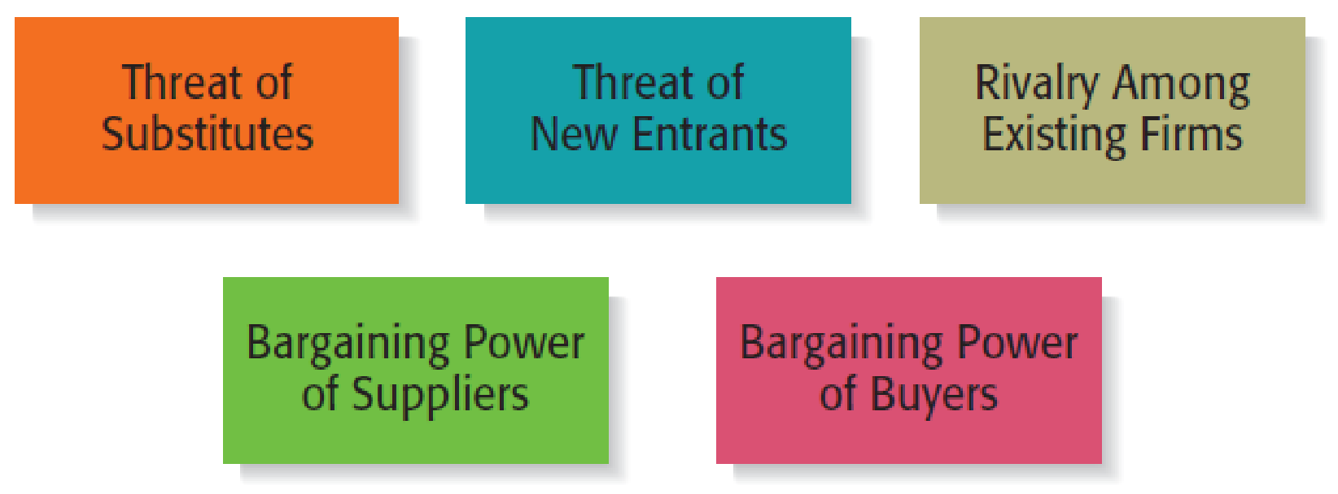
The Five Competitive Forces Model 3 of 3
Copyright ©2016 Pearson Education, Inc.
5-‹#›

Slide 12
Threat of Substitutes 1 of 3
Threat of Substitutes
The price that consumers are willing to pay for a product depends in part on the availability of substitute products.
For example, there are few, if any, substitutes for prescription medicines, which is one of the reasons the pharmaceutical industry is so profitable.
In contrast, when close substitutes for a product exist, industry profitability is suppressed, because consumers will opt out if the price gets too high.
Copyright ©2016 Pearson Education, Inc.
5-‹#›

Slide 13
Threat of Substitutes 2 of 3
Threat of Substitutes (continued)
The extent to which substitutes suppress the profitability of an industry depends on the propensity for buyers to substitute between alternatives.
This is why firms in an industry often offer their customers amenities to reduce the likelihood that they will switch to a substitute product, even in light of a price increase.
Copyright ©2016 Pearson Education, Inc.
5-‹#›

Slide 14

Threat of Substitutes 3 of 3
This independently owned
coffee shop doesn’t just sell
coffee.
It also offers its patrons a
convenient and pleasant place
to meet, socialize, and study.
It provides these amenities to
decrease the likelihood that its
customers will “substitute”
coffee at this shop for less
expensive alternatives.
Copyright ©2016 Pearson Education, Inc.
5-‹#›

Slide 15
Threat of New Entrants 1 of 6
Threat of New Entrants
If the firms in an industry are highly profitable, the industry becomes a magnet to new entrants.
Unless something is done to stop this, the competition in the industry will increase, and average industry profitability will decline.
Firms in an industry try to keep the number of new entrants low by erecting barriers to entry.
A barrier to entry is a condition that creates a disincentive for a new firm to enter an industry.
Copyright ©2016 Pearson Education, Inc.
5-‹#›

Slide 16
Threat of New Entrants 2 of 6
Barriers to Entry
Barrier to Entry
Explanation
Industries that are characterized by large economies of scale are difficult for new firms to enter, unless they are willing to accept a cost disadvantage.
Economies of Scale
Industries such as the soft drink industry that are characterized by firms with strong brands are difficult to break into without spending heavily on advertising.
Product differentiation
Capital requirements
The need to invest large amounts of money to gain entrance to an industry is another barrier to entry.
Copyright ©2016 Pearson Education, Inc.
5-‹#›

Slide 17
Threat of New Entrants 3 of 6
Barriers to Entry (continued)
Barrier to Entry
Explanation
Existing firms may have cost advantages not related to size. For example, the existing firms in an industry may have purchased land when it was less expensive than it is today.
Cost advantages independent of size
Distribution channels are often hard to crack. This is particularly true in crowded markets, such as the convenience store market.
Access to distribution channels
Government and legal barriers
Some industries, such as banking and broadcasting, require the granting of a license by a public authority to compete.
Copyright ©2016 Pearson Education, Inc.
5-‹#›

Slide 18
Threat of New Entrants 4 of 6
Nontraditional Barriers to Entry
It is difficult for start-ups to execute barriers to entry that are expensive, such as economies of scale, because money is usually tight.
Start-ups have to rely on nontraditional barriers to entry to discourage new entrants, such as assembling a world-class management team that would be difficult for another company to replicate.
Copyright ©2016 Pearson Education, Inc.
5-‹#›

Slide 19
Threat of New Entrants 5 of 6
Nontraditional Barriers to Entry
Barrier to Entry
Explanation
If a start-up puts together a world-class management team, it may give potential rivals pause in taking on the start-up in its chosen industry.
Strength of management team
If a start-up pioneers an industry or a new concept within an industry, the name recognition the start-up establishes may create a barrier to entry.
First-mover advantage
If the employees of a start-up are motivated by the unique culture of a start-up, and anticipate a large financial reward, this is a combination that cannot be replicated by larger firms.
Passion of the management team and employees
Copyright ©2016 Pearson Education, Inc.
5-‹#›

Slide 20
Threat of New Entrants 6 of 6
Nontraditional Barriers to Entry (continued)
Barrier to Entry
Explanation
If a start-up is able to construct a unique business model and establish a network of relationships that makes the business model work, this set of advantages creates a barrier to entry.
Unique business model
Some Internet domain names are so “spot-on” that they give a start-up a meaningful leg up in terms of e-commerce opportunities.
Internet domain name
Inventing a new approach to an industry
If a start-up invents a new approach to an industry and executes it in an exemplary fashion, these factors create a barrier to entry for potential imitators.
Copyright ©2016 Pearson Education, Inc.
5-‹#›

Slide 21
Rivalry Among Existing Firms 1 of 3
Rivalry Among Existing Firms
In most industries, the major determinant of industry profitability is the level of competition among existing firms.
Some industries are fiercely competitive, to the point where prices are pushed below the level of costs, and industry-wide losses occur.
In other industries, competition is much less intense and price competition is subdued.
Copyright ©2016 Pearson Education, Inc.
5-‹#›

Slide 22
Rivalry Among Existing Firms 2 of 3
Factors that determine the intensity of the rivalry among existing firms in an industry
Number and balance of competitors
The more competitors there are, the more likely it is that one or more will try to gain customers by cutting its price.
Degree of difference between products
The degree to which products differ from one product to another affects industry rivalry.
Copyright ©2016 Pearson Education, Inc.
5-‹#›

Slide 23
Rivalry Among Existing Firms 3 of 3
Factors that determine the intensity of the rivalry among existing firms in an industry (continued)
The competition among firms in a slow-growth industry is stronger than among those in fast-growth industries.
Growth rate of an industry
Firms that have high fixed costs must sell a higher volume of their product to reach the break-even point than firms with low fixed costs.
Level of fixed costs
Copyright ©2016 Pearson Education, Inc.
5-‹#›

Slide 24
Bargaining Power of Suppliers 1 of 3
Bargaining Power of Suppliers
Suppliers can suppress the profitability of the industries to which they sell by raising prices or reducing the quality of the components they provide.
If a supplier reduces the quality of the components it supplies, the quality of the finished product will suffer, and the manufacturer will eventually have to lower its price.
If the suppliers are powerful relative to the firms in the industry to which they sell, industry profitability can suffer.
Copyright ©2016 Pearson Education, Inc.
5-‹#›

Slide 25
Bargaining Power of Suppliers 2 of 3
Factors that have an impact on the ability of suppliers to exert pressure on buyers
Supplier concentration
When there are only a few suppliers that supply a critical product to a large number of buyers, the supplier has an advantage.
Switching costs are the fixed costs that buyers encounter when switching or changing from one supplier to another. If switching costs are high, a buyer will be less likely to switch suppliers.
Switching costs
Copyright ©2016 Pearson Education, Inc.
5-‹#›

Slide 26
Bargaining Power of Suppliers 3 of 3
Factors that have an impact on the ability of suppliers to exert pressure on buyers (continued)
Attractiveness of substitutes
Supplier power is enhanced if there are no attractive substitutes for the product or services the supplier offers.
Threat of forward integration
The power of a supplier is enhanced if there is a credible possibility that the supplier might enter the buyer’s industry.
Copyright ©2016 Pearson Education, Inc.
5-‹#›

Slide 27
Bargaining Power of Buyers 1 of 3
Bargaining Power of Buyers
Buyers can suppress the profitability of the industries from which they purchase by demanding price concessions or increases in quality.
For example, the automobile industry is dominated by a handful of large companies that buy products from thousands of suppliers in different industries. This allows the automakers to suppress the profitability of the industries from which they buy by demanding price reductions.
Copyright ©2016 Pearson Education, Inc.
5-‹#›

Slide 28
Bargaining Power of Buyers 2 of 3
Factors that have an impact on the ability of buyers to exert pressure on suppliers
If there are only a few large buyers, and they buy from a large number of suppliers, they can pressure the suppliers to lower costs and thus affect the profitability of the industries from which they buy.
Buyer group concentration
The greater the importance of an item is to a buyer, the more sensitive the buyer will be to the price it pays.
Buyer’s costs
Copyright ©2016 Pearson Education, Inc.
5-‹#›

Slide 29
Bargaining Power of Buyers 3 of 3
Factors that have an impact on the ability of buyers to exert pressure on suppliers (continued)
Degree of standardization of supplier’s products
The degree to which a supplier’s product differs from its competitors affects the buyer’s bargaining power.
Threat of backward integration
The power of buyers is enhanced if there is a credible threat that the buyer might enter the supplier’s industry.
Copyright ©2016 Pearson Education, Inc.
5-‹#›

Slide 30
Class Activity
You've noticed a significant problem or inefficiency in a common everyday industry. Your mission is to analyze this industry using Five Forces model to determine its profitability:
The Coffee Shop Industry
The Used-Textbook Marke:
The E-Commerce Clothing Industry
Based on your chosen industry, answer the following questions:
Threat of New Entrants: What are the barriers to entry in this industry? How high is this threat for a new business?
Bargaining Power of Suppliers: Who are the key suppliers in this industry, and how much power do they have? (e.g., coffee bean producers, food wholesalers, clothing manufacturers).
Bargaining Power of Buyers: Who are the buyers and how much leverage do they have? (e.g., daily coffee drinkers, busy students, fashion-conscious consumers).
Threat of Substitutes: What are the most significant substitute products or services that could pull customers away?

Slide 31
Now, each group will select a single, direct competitor from the industry they just analyzed. Your task is to perform a detailed competitor analysis on this rival and create a Competitive Analysis Grid.
For example:
For the Coffee Shop Industry: Analyze Starbucks.
For the Textbook Market: Analyze Amazon.
For the Clothing Resale Industry: Analyze Diners.

Slide 32
First Application of the Five Forces Model 1 of 2
First Application of the Model
The five forces model can be used to assess the attractiveness of an industry by determining the level of threat to industry profitability for each of the forces.
If a firm fills out the form shown on the next slide and several of the threats to industry profitability are high, the firm may want to reconsider entering the industry or think carefully about the position it would occupy.
Copyright ©2016 Pearson Education, Inc.
5-‹#›

Slide 33
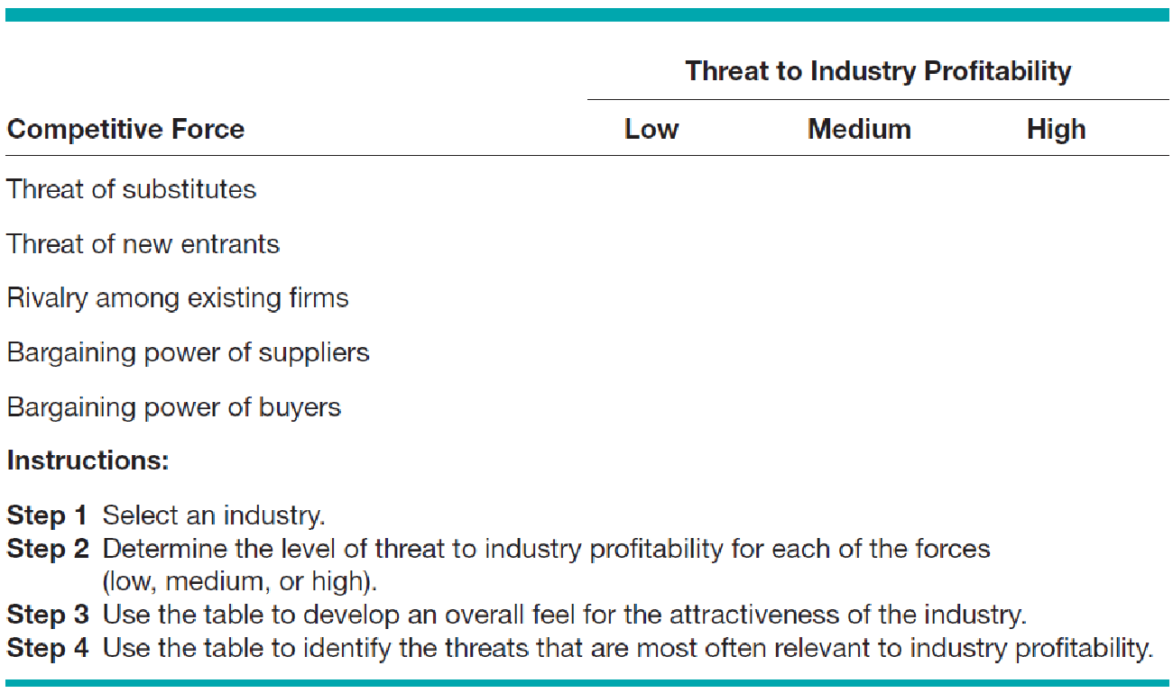
First Application of the Five Forces Model 2 of 2
Assessing Industry Attractiveness Using the Five Forces Model
Copyright ©2016 Pearson Education, Inc.
5-‹#›

Slide 34
Second Application of the Five Forces Model 1 of 2
Second Application of the Model
The second way a new firm can apply the five forces model to help determine whether it should enter an industry is by using the model to answer several key questions.
The questions are shown in the figure on the next slide, and help a firm project the potential success of a new venture in a particular industry.
Copyright ©2016 Pearson Education, Inc.
5-‹#›

Slide 35
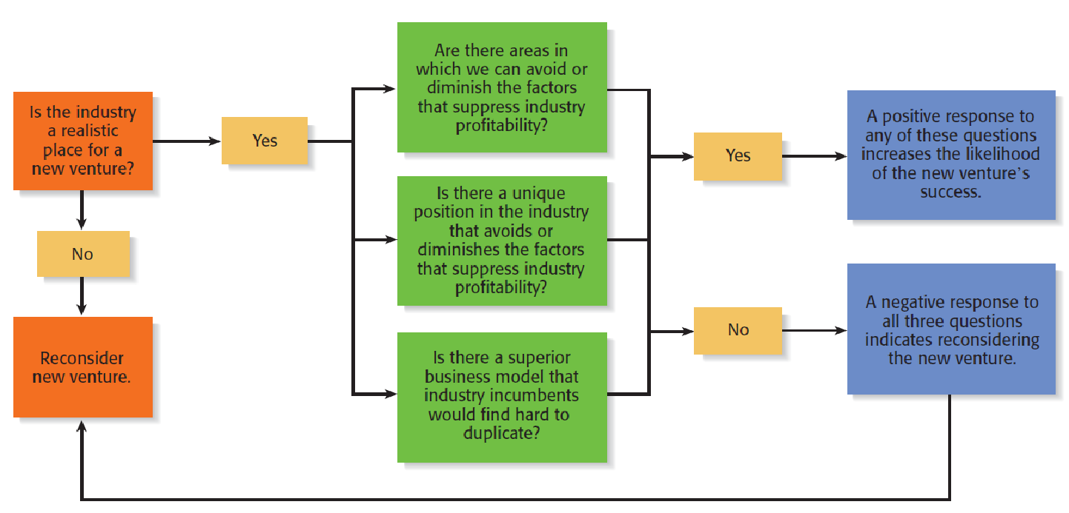
Second Application of the Five Forces Model 2 of 2
Using the Five Forces Model to Pose Questions to Determine the Potential Success of a New Venture in an Industry
Copyright ©2016 Pearson Education, Inc.
5-‹#›

Slide 36
Industry Types and the Opportunities They Offer 1 of 3
Emerging Industries
Industries in which standard operating procedures have yet to be developed.
Opportunity: First-mover advantage.
Fragmented Industries
Industries that are characterized by a large number of firms of approximately equal size.
Opportunity: Consolidation.
Copyright ©2016 Pearson Education, Inc.
5-‹#›

Slide 37
Industry Types and the Opportunities They Offer 2 of 3
Mature Industries
Industries that are experiencing slow or no increase in demand.
Opportunities: Process innovation and after-sale service innovation.
Declining Industries
Industries that are experiencing a reduction in demand.
Opportunities: Leadership, establishing a niche market, and pursuing a cost reduction strategy.
Copyright ©2016 Pearson Education, Inc.
5-‹#›

Slide 38
Industry Types and the Opportunities They Offer 3 of 3
Global Industries
Industries that are experiencing significant international sales.
Opportunities: Multidomestic and global strategies.
Copyright ©2016 Pearson Education, Inc.
5-‹#›

Slide 39
Competitor Analysis
What is a Competitor Analysis?
A competitor analysis is a detailed analysis of a firm’s competition.
It helps a firm understand the positions of its major competitors and the opportunities that are available.
A competitive analysis grid is a tool for organizing the information a firm collects about its competitors.
Copyright ©2016 Pearson Education, Inc.
5-‹#›

Slide 40
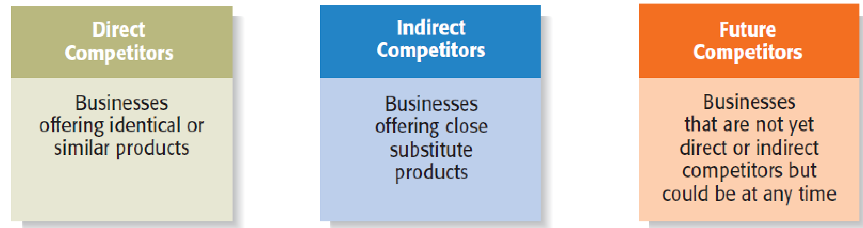
Identifying Competitors
Types of Competitors New Ventures Face
Copyright ©2016 Pearson Education, Inc.
5-‹#›

Slide 41
Sources of Competitive Intelligence 1 of 2
Collecting Competitive Intelligence
To complete a competitive analysis grid, a firm must first understand the strategies and behaviors of its competitors.
The information that is gathered by a firm to learn about its competitors is referred to as competitive intelligence.
A new venture should take care that it collects competitive intelligence in a professional and ethical manner.
Copyright ©2016 Pearson Education, Inc.
5-‹#›

Slide 42
Sources of Competitive Intelligence 2 of 2
Ethical ways to obtain information about competitors
Attend conferences and trade shows.
Purchase competitors’ products.
Study competitors’ Web sites and social media sites.
Set up Google e-mail alerts.
Read industry-related books, magazines, and Web sites.
Talk to customers about what motivated them to buy your
product as opposed to your competitor’s product.
Copyright ©2016 Pearson Education, Inc.
5-‹#›

Slide 43
Completing a Competitive Analysis Grid
Competitive Analysis Grid
A tool for organizing the information a firm collects about its competitors.
A competitive analysis grid can help a firm see how it stacks up against its competitors, provide ideas for markets to pursue, and identify its primary sources of competitive advantage.
Copyright ©2016 Pearson Education, Inc.
5-‹#›

Slide 44
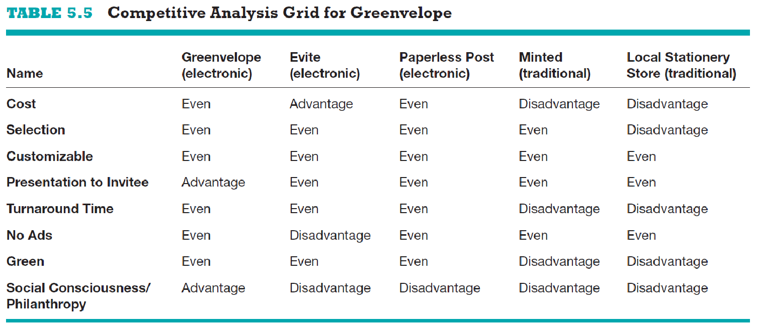
Competitive Analysis Grid for Element Bars
Copyright ©2016 Pearson Education, Inc.
5-‹#›

Slide 45

Copyright ©2016 Pearson Education, Inc.
5-‹#›

